Slide 1







Technology Stack
Tkrr.github.io/CrammingClique
User Interface Framework: Material UI
JavaScript Framework: JQuery
User Interface
Application Hosting
Application Hosting: GitHub Pages
Database: Firebase
User Security: Google Signin
User Notification: Twilio
Address Validation: Google Maps
Backend Utility Services

Slide 2
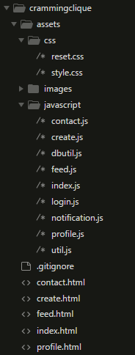
Application Code Structure
Common style across all pages
All database operations developed as common reusable functions which can be called from any page of the app. It also simplifies the effort if we decide to use a different database other than Firebase
A single JS file houses all security related functions. Can be easily extended to support other login options such as Facebook login
Reusable function for text notification
All utility functions are housed in its own JS file
5 different html pages each supporting a different functionality of the app

Slide 3
Project Backlog
Easy Enhancement
Manage Clique: Give ability to modify or delete an event
Display events in sorted order by event date, with the event closest to the current date shown at the top
Drop past events
Update the events pages dynamically with new events. Currently page has to be refreshed to view new events
View event host details
View attendee details
Long term Enhancements
Add event search capability
Email notification
Add to google calendar
Add comments and respond to comments under every event

